Slide 1
Vikings
By Chloe Redwood

Slide 2
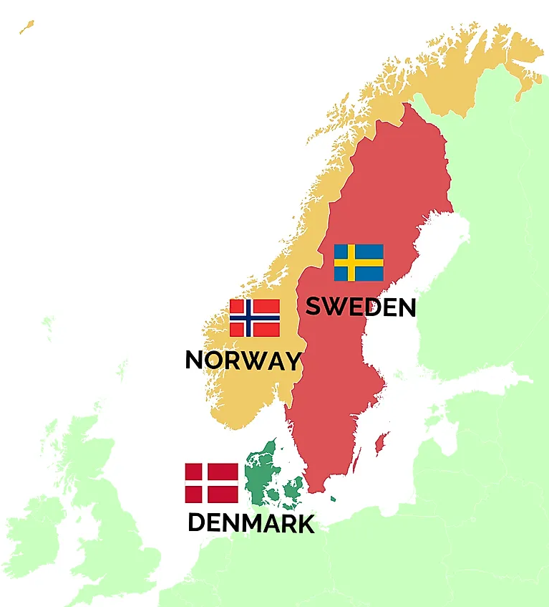
Origins
Vikings originally came from Scandinavia or Norway, Sweden and Denmark
They were called Norsemen or Northmen because they lived in Northern Europe
Vikings sailed to Britain in large wooden boats called longships
They often were out to sea for weeks or even months sometimes

Slide 3
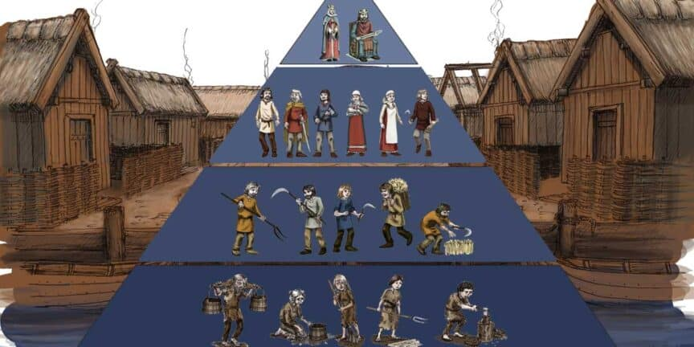
Culture
The Vikings had 3 society classes the kings, Jarls (reporters to the king), Karls (freemen) and Thralls (slaves)
Women were not equals to men but they had some rights
While the men were fighting, women had to farm and look after children whilst doing their jobs too
Vikings played sports like mountain climbing, swimming, javelin-throwing and hunting

Slide 4
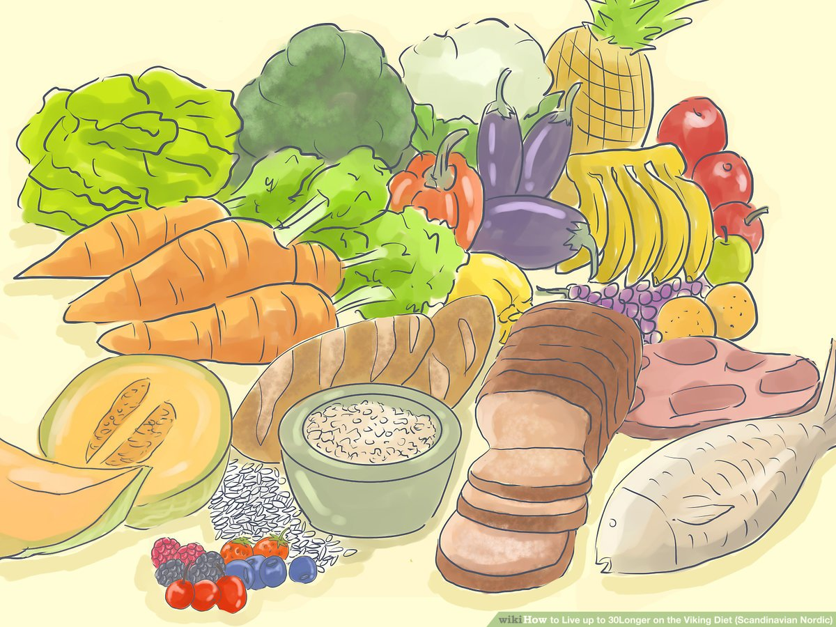
Diet
The Viking ate pretty healthily and they ate meat, fish and vegetables
They enjoyed feasts and they celebrated seasonal events such as Winter Nights and Jul, harvest festivals like Mabon and religious rituals
There aren't any exact Viking recipes known, but archeological evidence and records give people plenty of ideas of the type of dishes they made

Slide 5
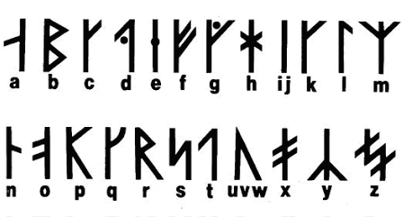
language
Old Norse was spoken in Scandinavia and the Vikings took their language to Britain
Some Norse words include atori which is mouldy or old, bec which is a stream or river, bie which is a kind of jug and bette which is fishing bait

Slide 6
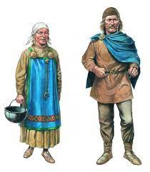
clothing
Finds of clothes from the Viking period are rare and the knowledge about Viking clothes supplemented by written sources on small figures and tapestries.
The Viking woman typically wore a strap dress with an undergarment or smock underneath
The Viking male often wore a tunic, trousers and a cloak

Slide 7
Vocabulary cards
Word
Viking
Longship
Spear
Conflict
Raid
Warrior
Beserkers
Impact
Danegeld
Scandinavia
Definition
A person from Scandinavia who raided parts of Europe. They were warriors farmers and craftsmen.
A large wooden boat used by Vikings to travel and raid
A long, sharp weapon used by Vikings
A struggle or disagreement between two or more groups
A rapid surprise attack on an enemy
A brave or experienced fighter of soldier
A ancient Norse warrior that fights with wild and uncontrolled ferocity
A powerful influence or effect on someone or something
A tax paid to the Vikings by the Anglo Saxons
A name to cover the 3 countries of Norway, Sweden and Denmark

Slide 8
The end
I hope you enjoyed this Powerpoint!

